Slide 1
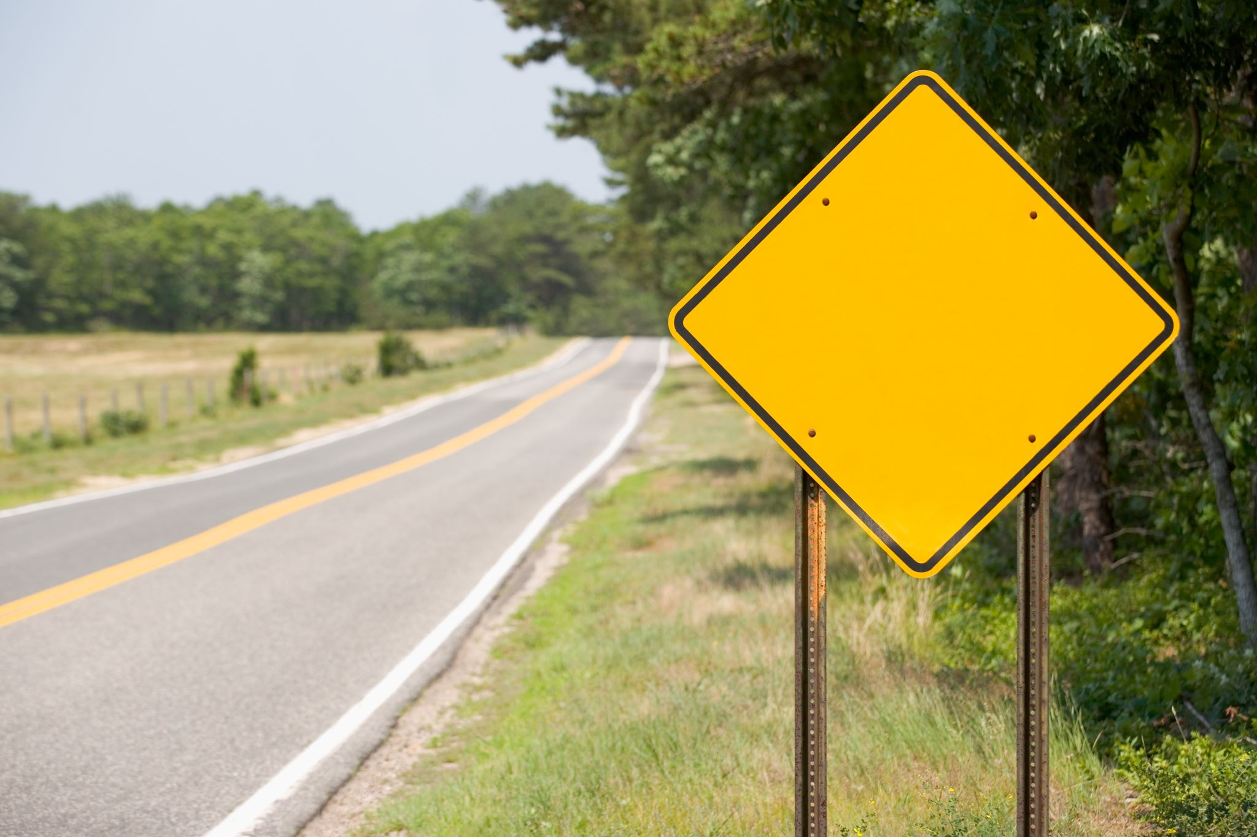
Data Augmentation for Road Sign Detection
Francesco Azzoni, Corrado Fasana, Samuele Pasini

Slide 2
Analyzed papers
Zhu et al. – Emotion Classification with Data Augmentation Using Generative Adversarial Networks [Zhu2017]
Zhang and Zhou - ECycleGAN: Enhanced Cycle-Consistent Generative Adversarial Networks [Zhang2020]
Jackson et al. - Style Augmentation: Data Augmentation via Style Randomization [Jackson2019]

Slide 3
Zhu2017
They propose an adversarial augmentation technique in order to balance the emotion dataset using domain transfer
They use CycleGAN to build the framework
LSGAN is used as adversarial loss

Slide 4
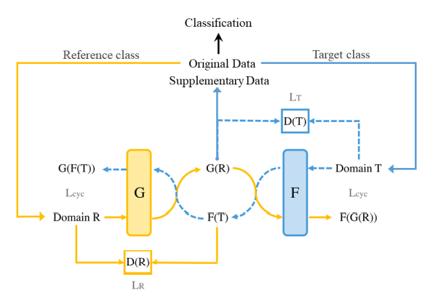
CycleGAN

Slide 5
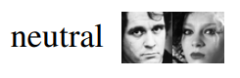
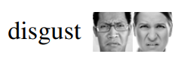
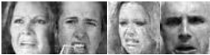
CycleGAN in emotion classification

Slide 6
Results
There is an improvement in distribution integrity and margin clarity between classes
Accuracy of emotion classification task increases significantly

Slide 7
Zhang2020
They modify CycleGAN in order to improve the quality of the generated images
They show superiority in domain translation (not specifically in emotion classification)
The introduced model is named ECycleGAN

Slide 8
CycleGAN vs ECycleGAN
CycleGAN
ECycleGAN
Residual blocks as the basic network building unit
LSGAN as the adversarial loss
Cycle consistency based on low-level pixel-wise error measures (pixel similarity)
Residual Dense Normalization Block
WGAN-GP as the adversarial loss
Cycle consistency based on features extracted from a VGG19 network (perceptual similarity)

Slide 9
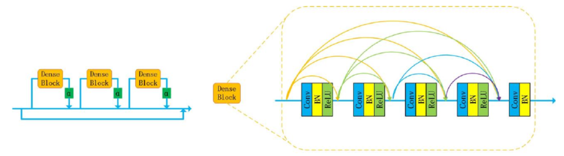
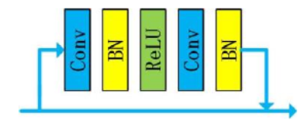
CycleGAN vs ECycleGAN
RDNB
Residual block

Slide 10
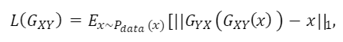
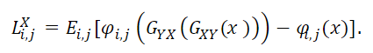
CycleGAN vs ECycleGAN
Pixel Similarity
Perceptual Loss

Slide 11
Jakson2019
They introduce style augmentation, a form of augmentation based on random style transfer
Style augmentation randomizes color, texture and constrast
Style augmentation preserves shapes and semantic content
They use a style transfer network to perform style randomization
They sample the style embedding from a specific distribution instead of using a style image to derive the embedding

Slide 12
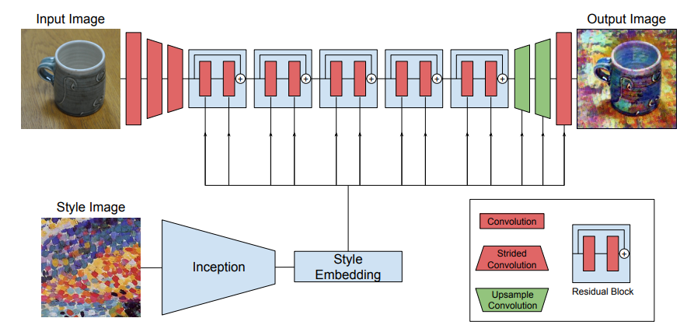
Standard style transfer pipeline

Slide 13
Proposed style transfer pipeline

Slide 14
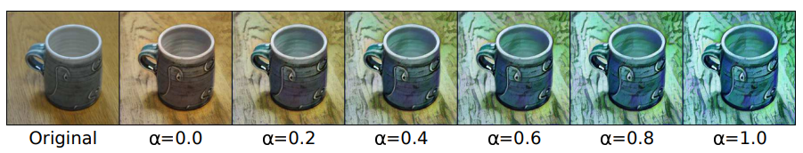
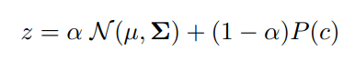
Randomization procedure

Slide 15
Our Idea
Exploit ECycleGANs to balance a dataset of road signs (some of which are less frequent than others).
Exploit the method proposed by [Jackson2019] to produce augmented versions of road signs under different weather conditions which is a crucial point for self-driving cars given that many models experience a decrease of performance in these cases.
Use a classifier to evaluate and compare results obtained with and without data augmentation.

Slide 16
Work Plan
Dataset Collection
Collect road sign dataset
Collect weather dataset for style augmentation
Collect road sign samples under difficult weather condition to be used as difficult test set
Classifier
Create a basic classification network
Evaluate the classification of road sign without any type of balancing and augmentation
Domain Transfer
Use CycleGAN for emotion classification, replicating results of Zhu2017
Use CycleGAN on the road sign dataset to balance it
Implement ECycleGAN and train on road sign dataset to balance it
Evaluate the classification performance using the balanced datasets from CycleGAN and ECycleGAN

Slide 17
Work Plan
Style augmentation
Derive the style embeddings from weather dataset
Use Jackson2019 on unbalanced road sign dataset
Evaluate the classification performance using the unbalanced style augmented dataset
Use Jackson2019 on the balanced dataset
Evaluate the classification performance using the balanced style augmented dataset

Slide 18
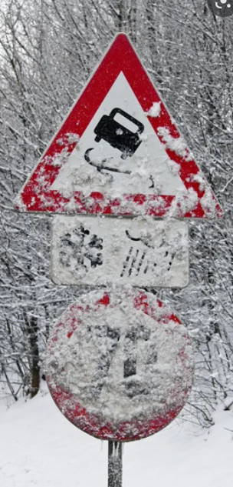
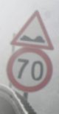
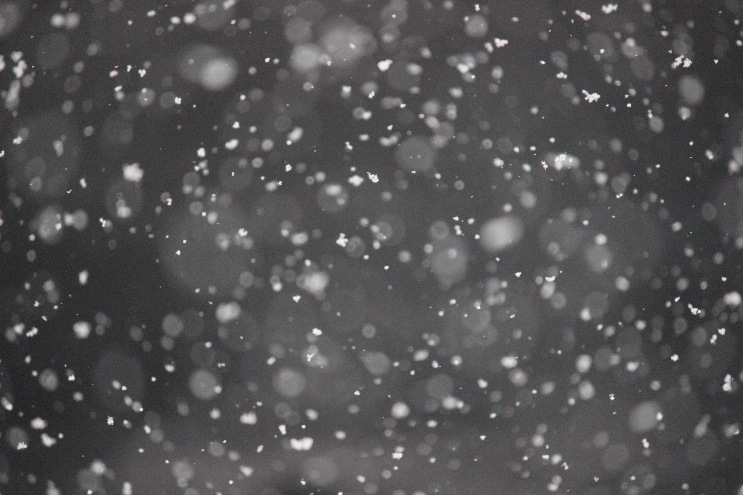

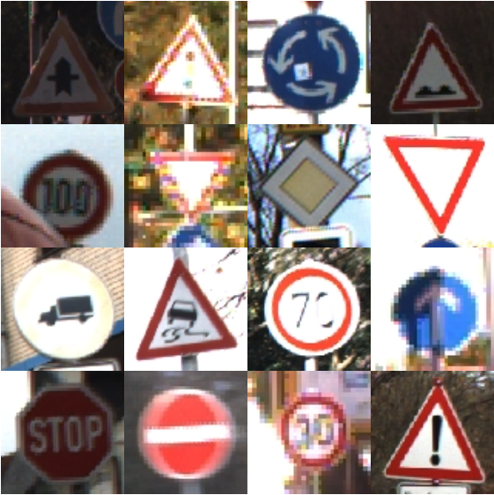

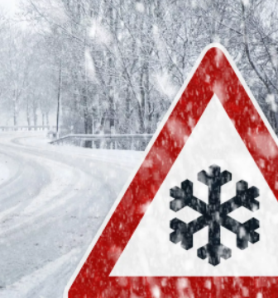
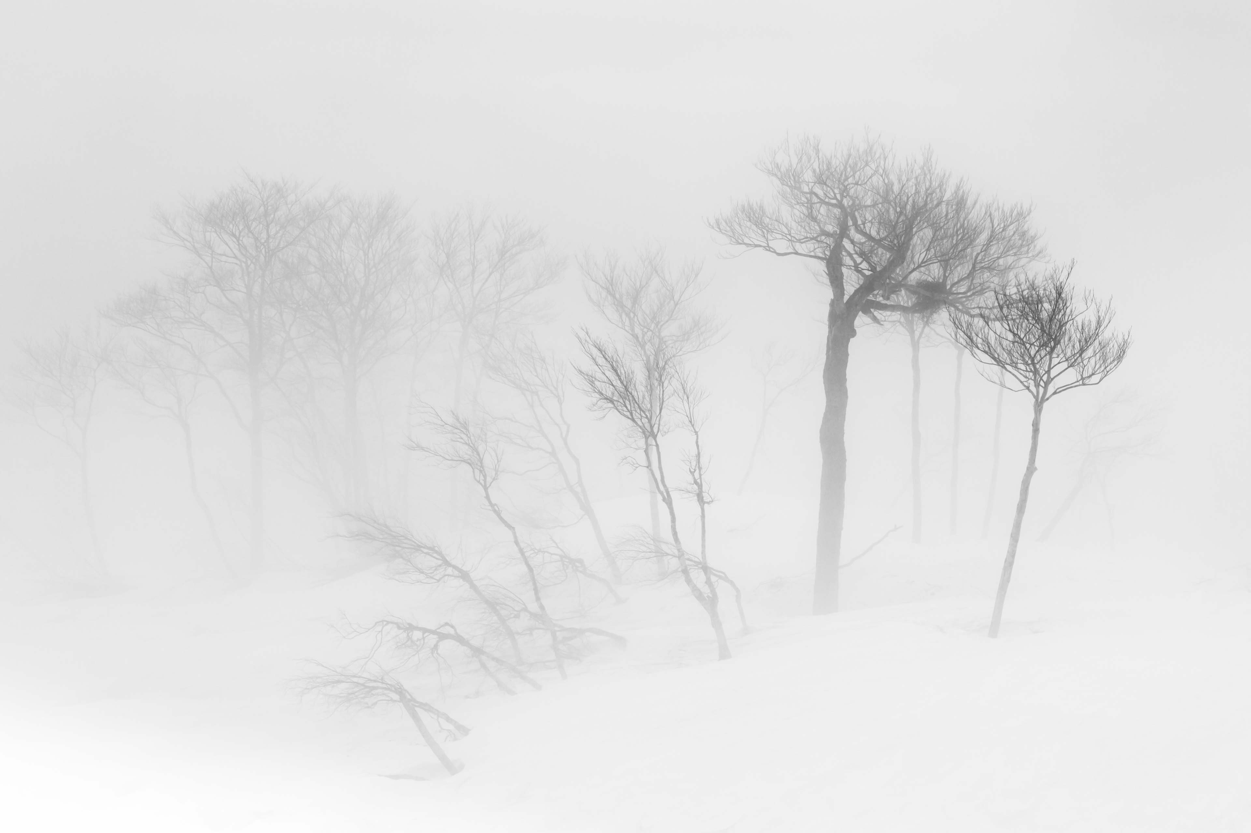
Visualization of the idea
Style augmented road sign dataset
Weather dataset
Road sign dataset

Slide 19
Thanks for the attention!

